Slide 1


YouTube Data Archiving And Purging Pipeline
Presented By:
Divya Sree Murali DE115
Jatin J DE120
Sivaprakash V DE138

Slide 2
Agenda
Project Overview
Project
Requirements
Solution Architecture
Demo
Results
Presentation Title

Slide 3

Project Overview
Dataset: "YouTube Trending Video Dataset" from Kaggle (updated daily).
Objective: Develop a data archiving and purging pipeline using Azure Data Factory.
Workflow Orchestration: Automates data ingestion, filtration, and storage.
Storage Containers: Archived data for analysis. Non-compliant data for purging.
Analytics and Visualization: Utilize Azure Databricks to analyze archived data. Extract insights on video engagement metrics and trends.
Key Features: Scalable and automated data management. Seamless integration of Azure tools for advanced analytics.

Slide 4
Project Requirements
Azure Data Factory
ADF automates data movement and transformation, creating pipelines.
Azure Databricks
It is a cloud-based analytics platform that processes large datasets and runs machine learning models. It transforms and analyzes data stored in Azure Data Lake to generate insights efficiently.
Azure Data Lake storage
Azure Data Lake Storage is a scalable repository for both raw and processed data. It stores health data ingested via ADF, allowing Databricks to access and process the data for further analysis.
Azure Blob storage:
Azure Blob Storage is a scalable, cloud-based object storage solution for storing large amounts of unstructured data, such as text or binary data.

Slide 5
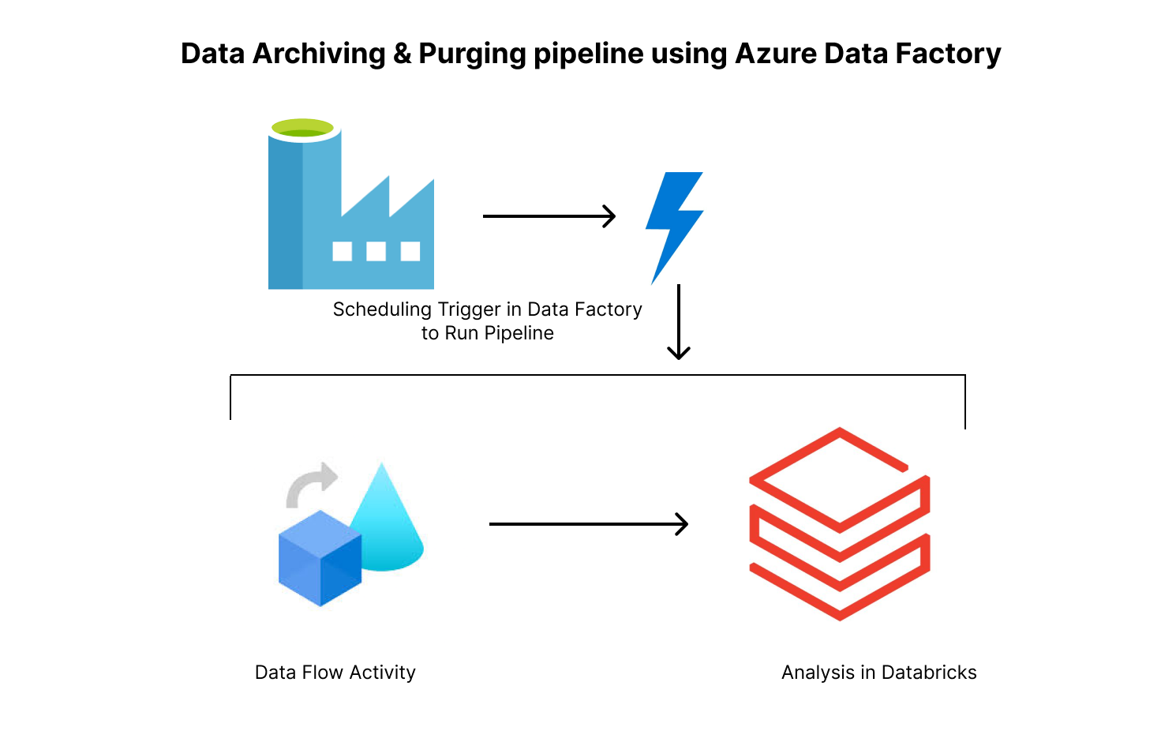
Solution Architecture
Data Ingestion:
The YouTube Trending Video dataset is ingested into Azure Data Lake Storage Gen2 (Bronze Layer) and seamlessly accessed via Azure Databricks using Azure Data Factory.
Data Filtration:
Three filtration techniques are applied: videos with views > 378,000, trended within 3 days, and a like-to-dislike ratio above 0.04129.
Data Routing:
Compliant data is moved to the Archive Container in the Gold Layer, while non-compliant data is moved to the Purging Container for deletion or future analysis.

Slide 6
Solution Architecture
Data Analysis and Visualization:
Compliant data from the Archive Container is loaded into Azure Databricks for advanced analysis and visualization of engagement metrics like views, likes, and comments. Insights such as trends in video categories and regional audience preferences are visualized using Databricks notebooks.

Slide 7
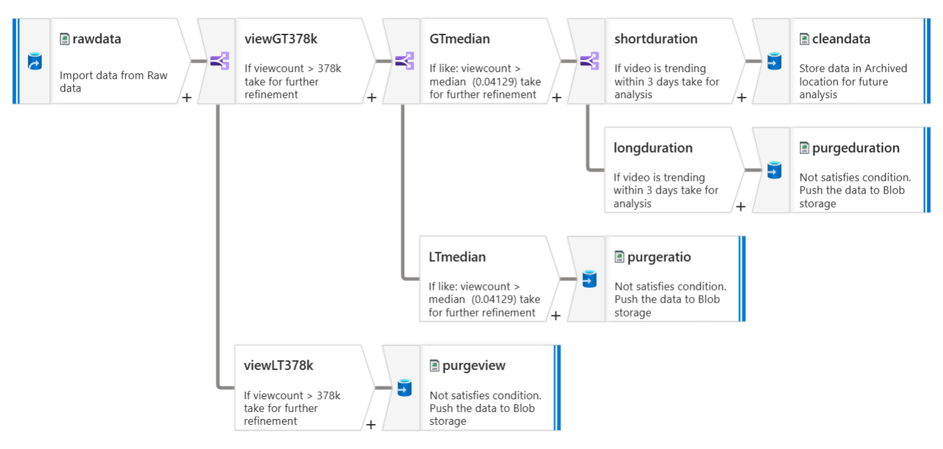
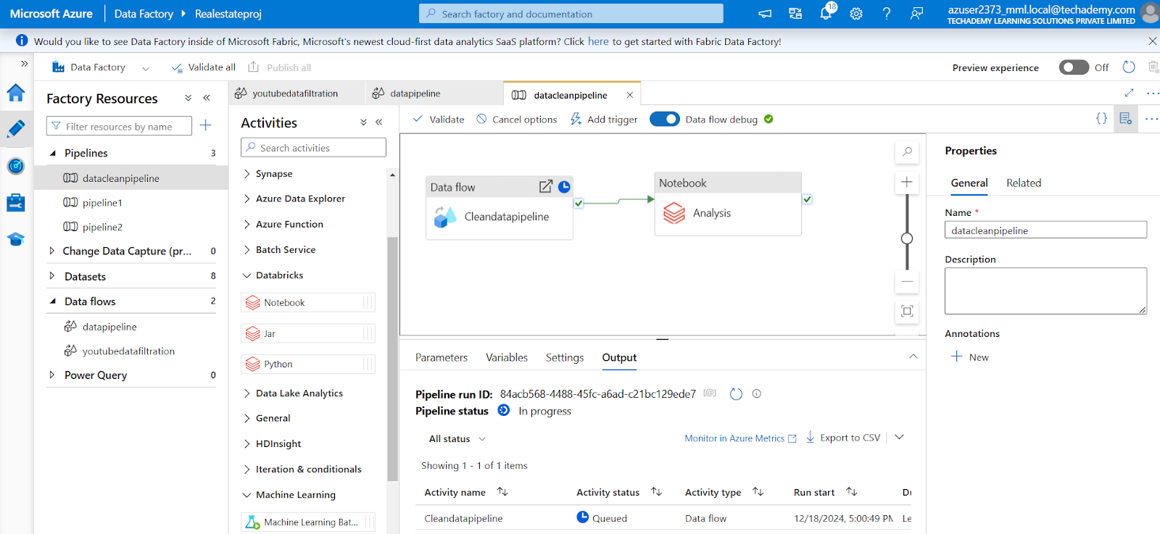
Dataflow Pipeline:

Slide 8
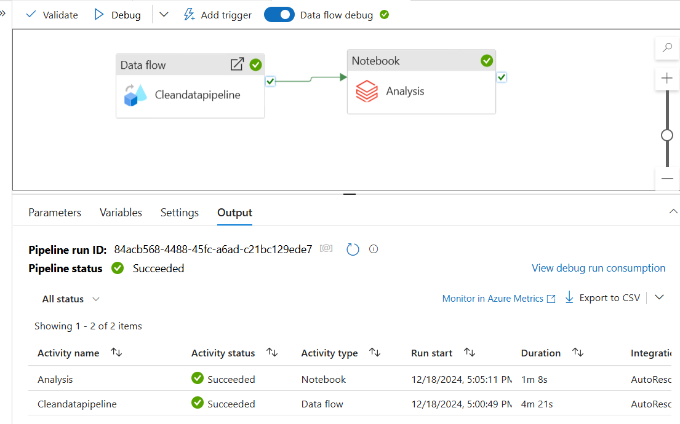
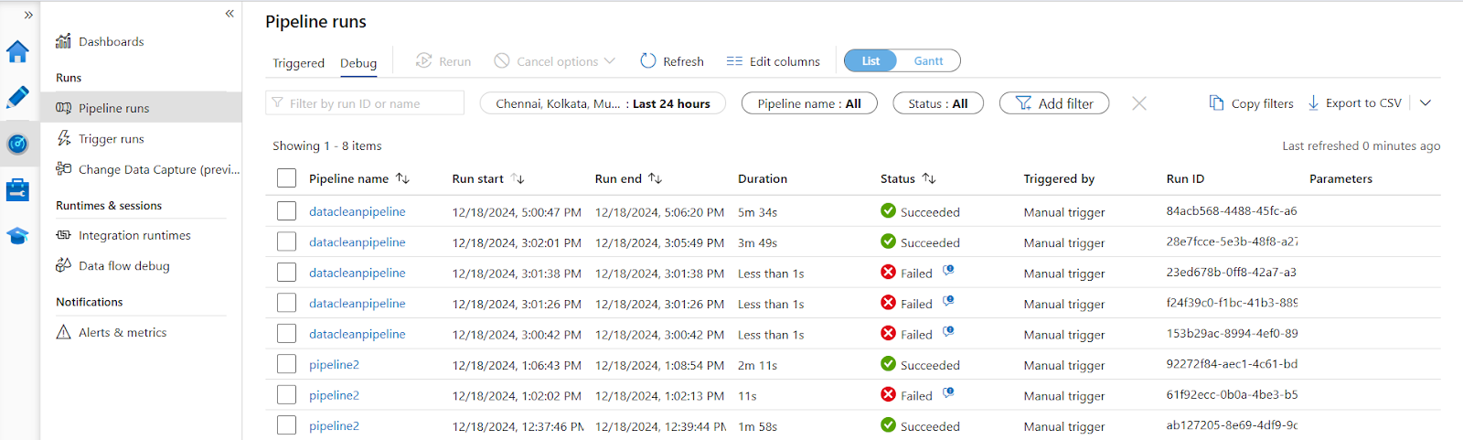
Pipeline Orchestration Results

Slide 9
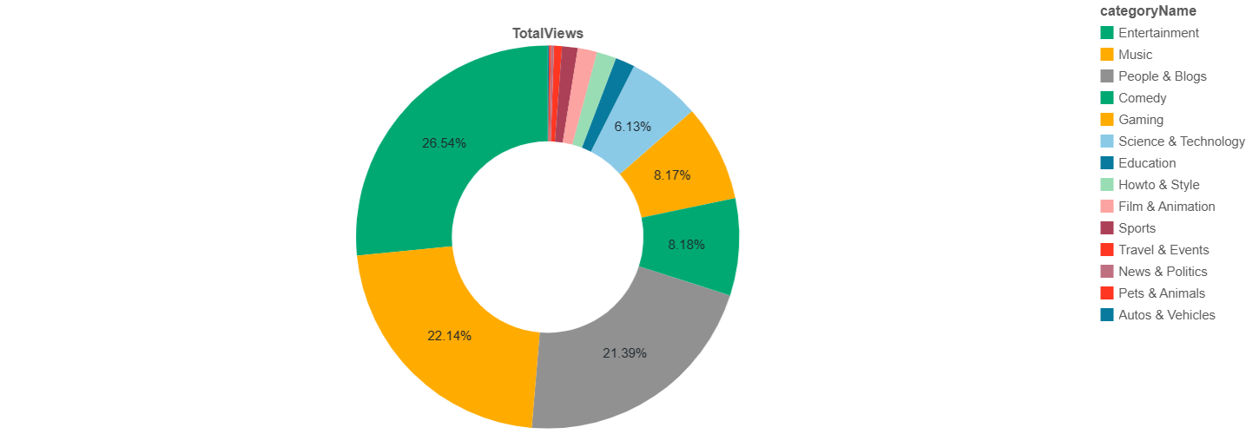
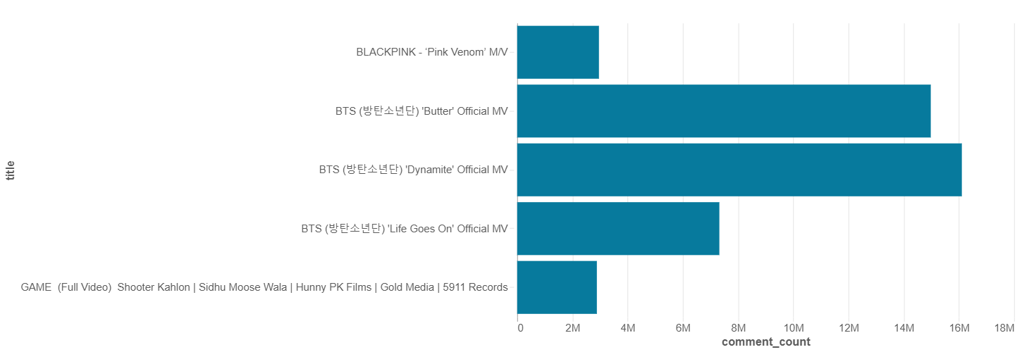
Archived Data Analysis Results
Total Views per category
Most commented Videos

Slide 10
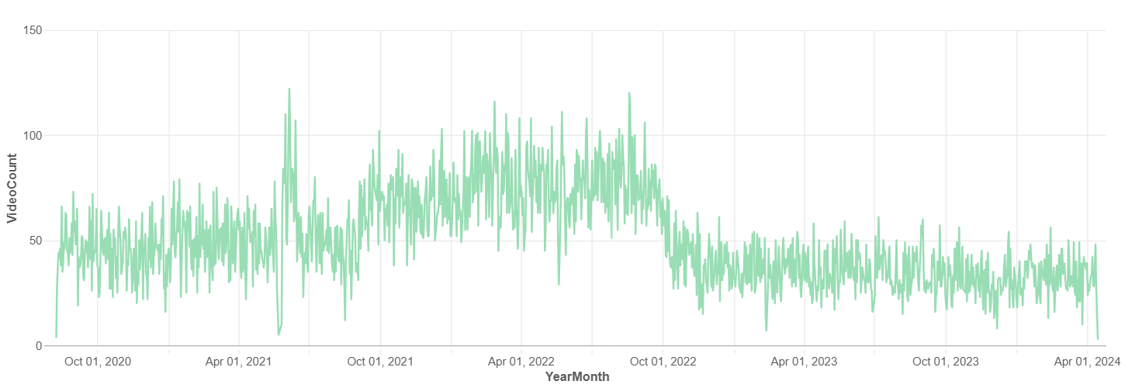
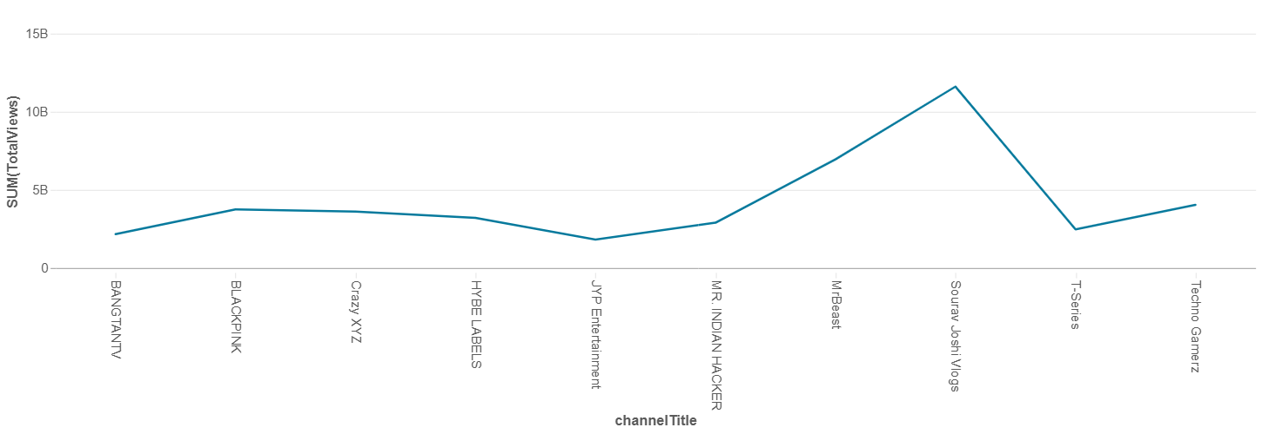
Archived Data Analysis Results
Publishing trend overtime
Top channel by Total Views

Slide 11
Conclusion
The solution involved designing a data engineering workflow using Azure Data Factory and Data Lake Storage Gen2 for seamless data ingestion, filtration, and storage.
Data was filtered based on key thresholds such as views, engagement metrics, and publish time to classify content for further analysis. Refined data was archived in Data Lake, while non-relevant data was directed to Blob Storage for efficient purging.
Automated workflows ensured efficient data processing and transformation, while Azure Databricks was leveraged for advanced analysis and visualization of engagement metrics.
This approach provided actionable insights, enabling data-driven decisions by uncovering trends and content performance patterns.

Slide 12




Thank you

